Slide 1
Spotify Clone
Advanced Web Design – Team Project

Slide 2



Technologies used
Git/GitHub
React
Spotify API

Slide 3
Core functionalities of the app
Login to Spotify using token
List user’s public playlists
List each track inside a playlist with its details
Go to previous or next track in the playlist
Pause/start the current track
Switch to another public playlist or track
Increase/decrease volume
All changes reflected in the original Spotify

Slide 4
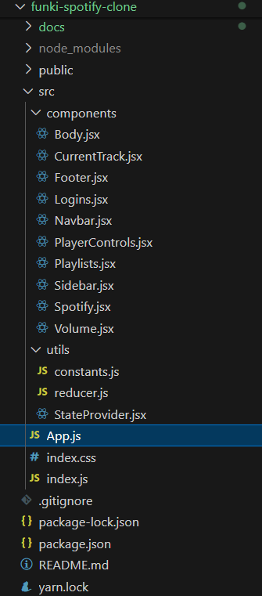
Project structure

Slide 5
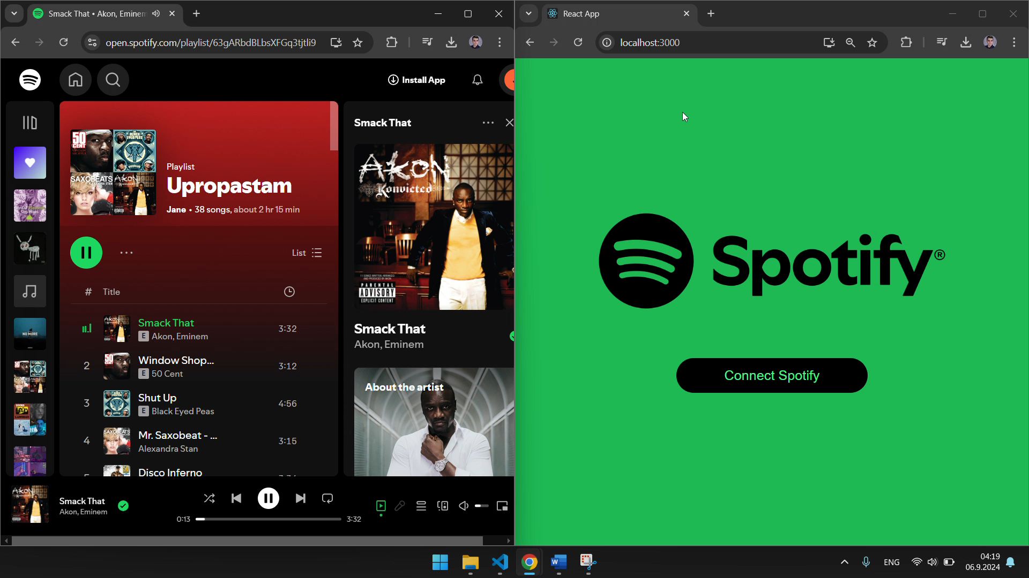

Slide 6
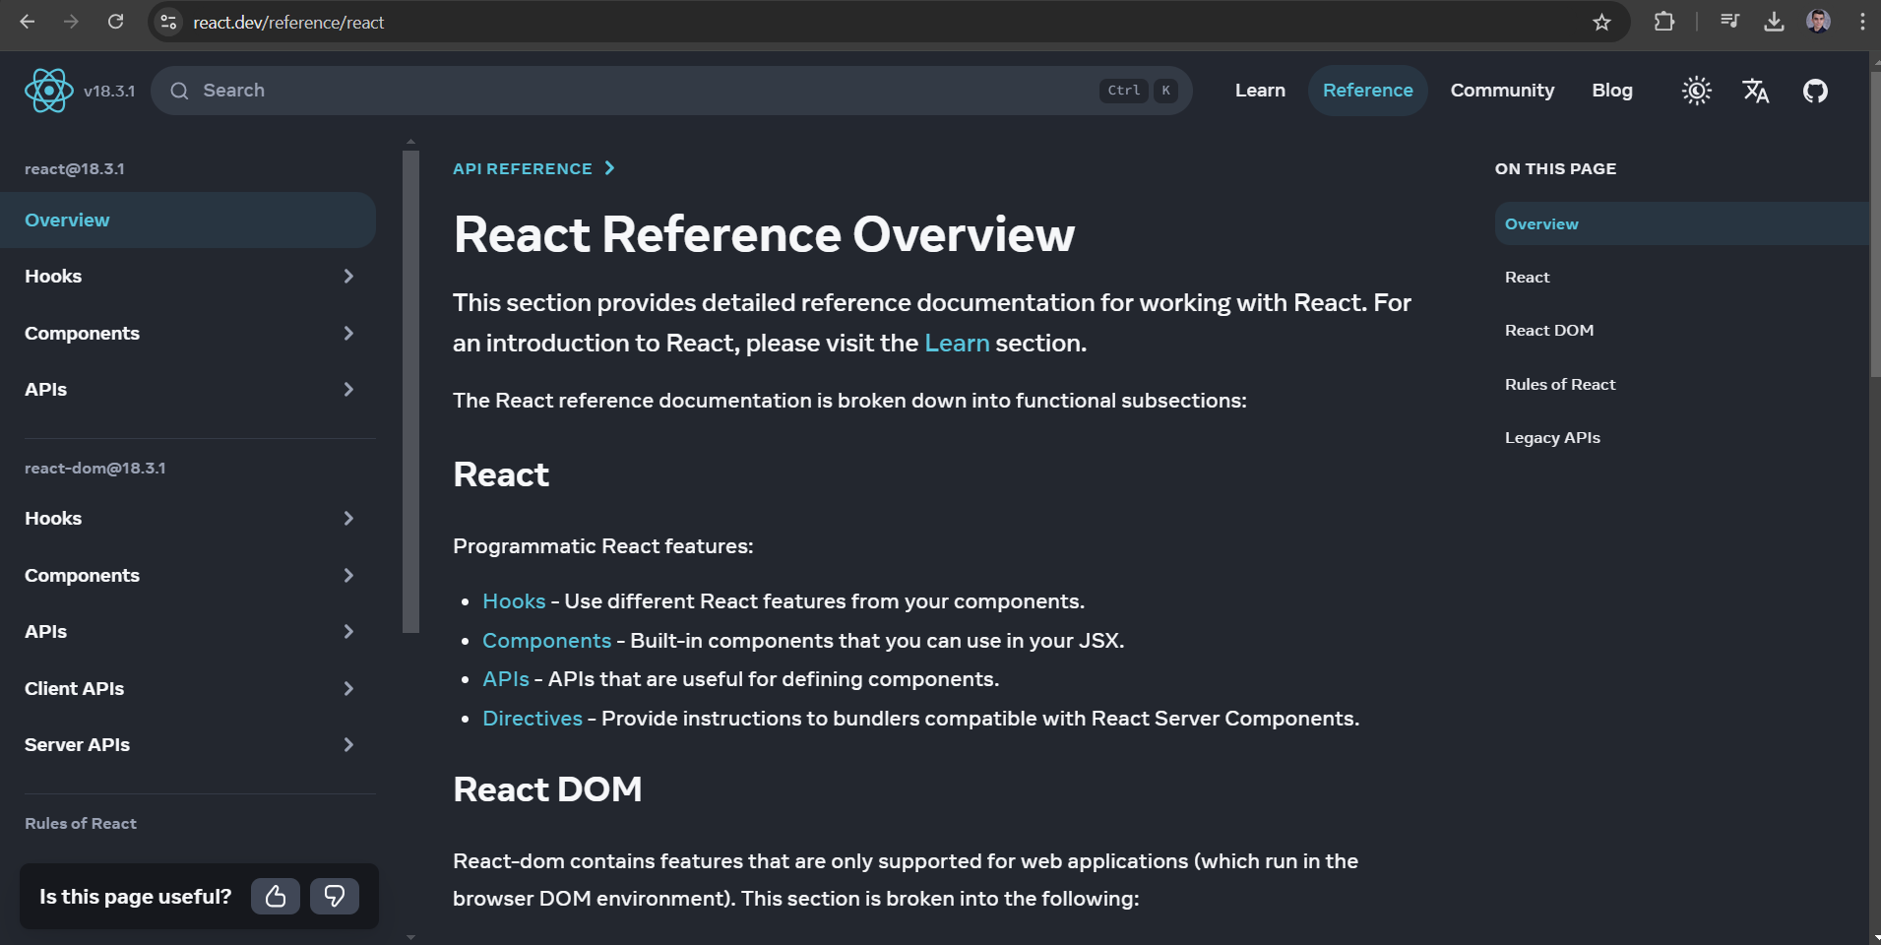
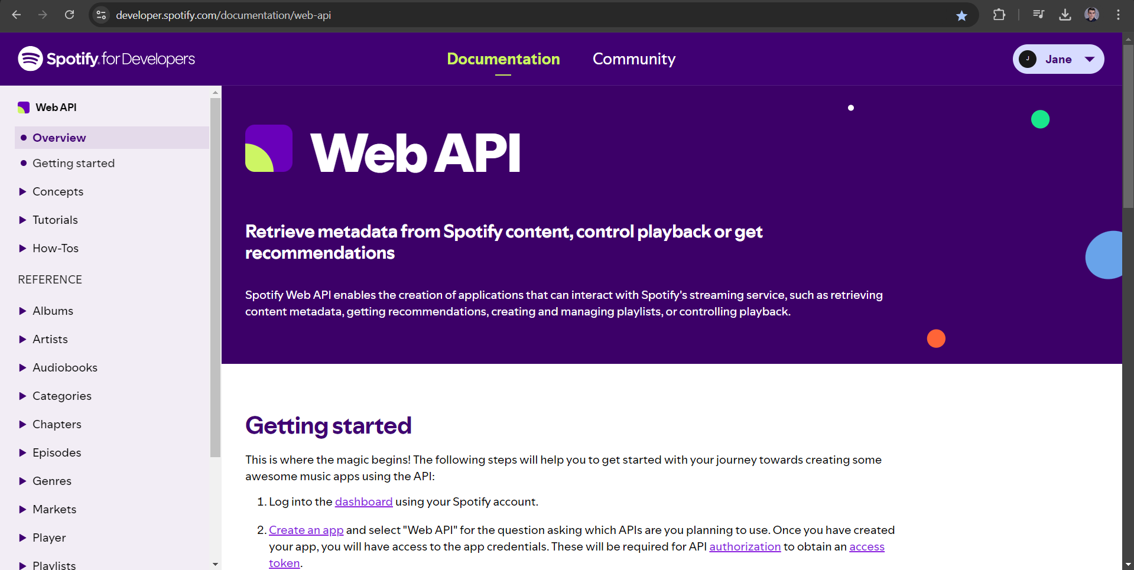

Useful resources

Slide 7


